Slide 1
201 Data Analytics Python
Capstone Project
“Chronic Diseases”
Present by: Thivadee Rachtawarn

Slide 2
Source : U.S. Chronic Disease Indicators (CDI)
CDC's Division of Population Health provides cross-cutting set of 124 indicators that were developed by consensus and that allows states and territories and large metropolitan areas to uniformly define, collect, and report chronic disease data that are important to public health practice and available for states, territories and large metropolitan areas. In addition to providing access to state-specific indicator data, the CDI web site serves as a gateway to additional information and data resources.
website: https://catalog.data.gov/dataset/u-s-chronic-disease-indicators-cdi-e50c9
From: Data World>> Sample No. 7

Slide 3
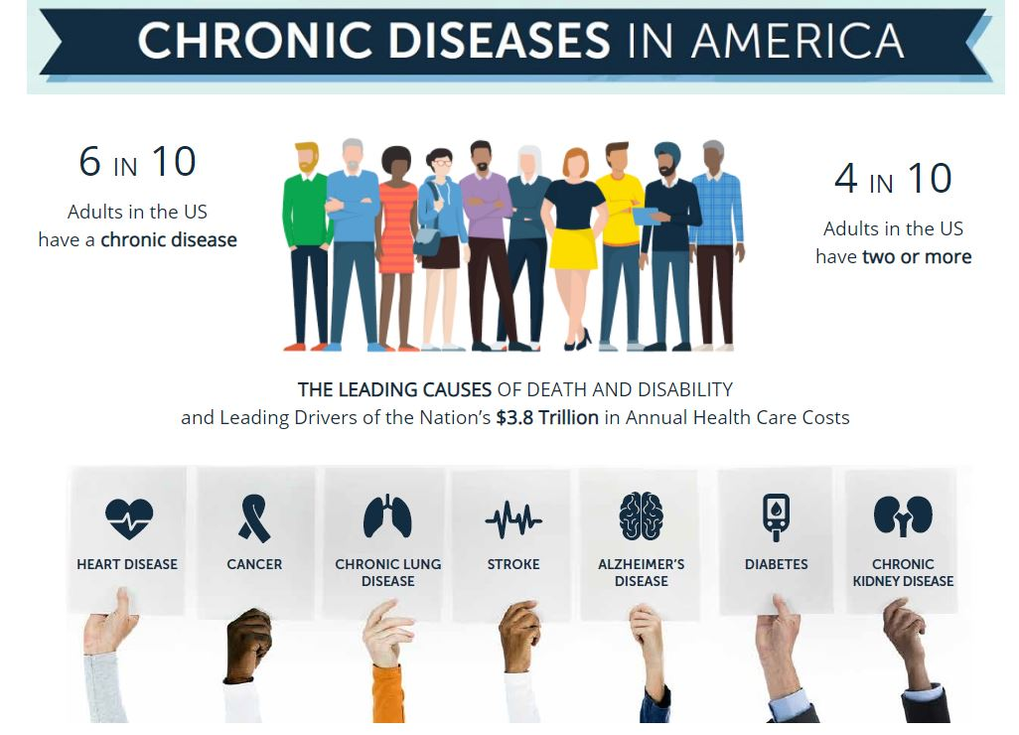

Slide 4
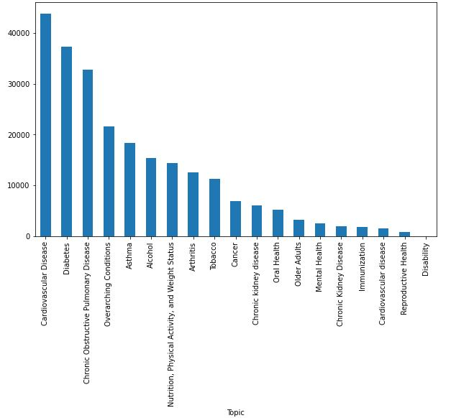

Slide 5
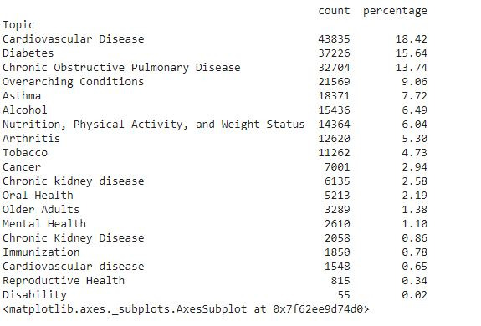
Summary: Chronic Disease

Slide 6
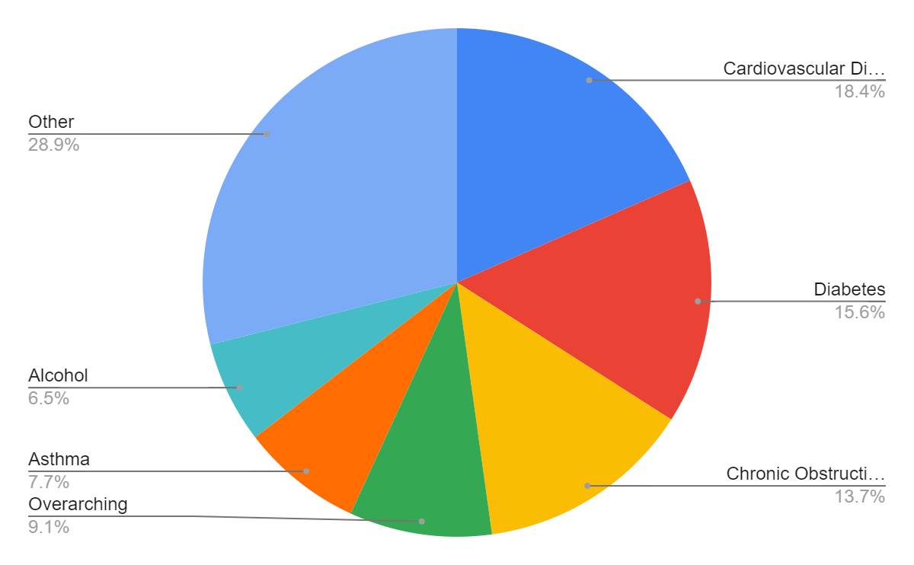
Top 6 Chronic Diseases based on CDI data 2001-2014

Slide 7



In the United state Cardiovascular disease cause :
1 IN 3 DEATHS
or more than 859,000 people each year.
$214
BILLION in health care system costs.
$138
BILLION
in lost productivity on the job from
premature death.

Slide 8
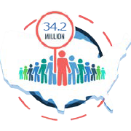
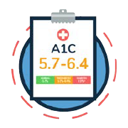
Fast Fact about Diabetes
34.2MILLION
Americans are living with diabetes. and
-- 4 of them don’t know they have it.
88 MILLION
people have prediabetes. and
-- 90% of them don’t know they have it.
$327 BILLION
is the annual estimated cost of diabetes in 2017

Slide 9

How to Prevent Chronic Illness with Small Lifestyle Changes

